Slide 1
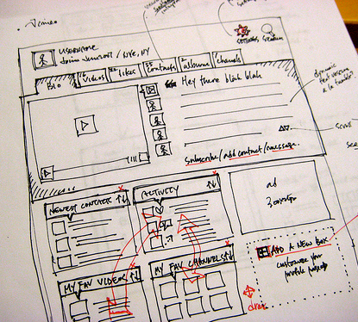
Interface Designs using Wireframes (Flow of Systems)
Mohammad Shahidh Mohammad Khaidir

Slide 2

Insertion
Inserting record
into database
User

Slide 3
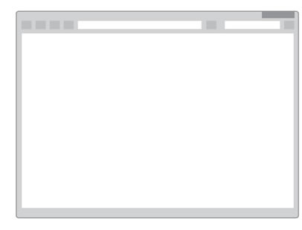
Home Page
Username
Password
Add Products
Edit Products
Delete Products
Search Products
Register
Buy
Sell
Find
Advertisement
Articles
More Articles >>
Product Images
More Products >>

Slide 4
Register - 1
Registration
First Name:
Upload Pic
Last Name:
Address:
Contact No:
Register

Slide 5
Register - 2
Registration
First Name:
Registration Successful.
Last Name:
X
Upload Pic
Address:
Contact No:
Ok
Register

Slide 6
Edit
Updating record
into database
Retrieve current
existing record
User

Slide 7
Update - 1
Name | ID
John | 005
Joe | 002
Lee | 003
…
…
+
+
+

Slide 8
Update - 2
Update
First Name:
Upload Pic
Last Name:
Address:
Contact No:
Save

Slide 9
Update - 3
Update
First Name:
Last Name:
Updated successfully.
Upload Pic
Address:
X
Contact No:
Ok
Save

Slide 10
Deletion
Deleting record
From database
Retrieve current
existing record
User

Slide 11
Delete - 1
Name | ID
John | 005
Joe | 002
Lee | 003
…
…
X
X
X

Slide 12
Delete - 2
Name | ID
John | 005
Joe | 002
Lee | 003
…
…
X
Are you sure you want to delete?
X
X
X
Yes
No

Slide 13
Delete - 3
Name | ID
John | 005
Joe | 002
Lee | 003
…
…
X
You have deleted the record
X
X
X
Ok

Slide 14
View
Retrieve current
existing record
User

Slide 15
Search - 1
Search
Name | ID | Gender
John | 005 | M
Joe | 002 | M
Lee | 003 | F
…
…

Slide 16
Search - 1
Search
Filter
By Age
By Dept
By Gender
Name | ID | Gender
John | 005 | M
Joe | 002 | M
Lee | 003 | F

